Slide 1
Shell Bootcamp 2024 3 Reflections for Week #2
HARSHIKA SOFAT
Date : 06-SEP-2024

Slide 2

About Me
Smile throughout the journey
Please share an image / visual that best represents you

Slide 3

My learnings from this week!

Slide 4
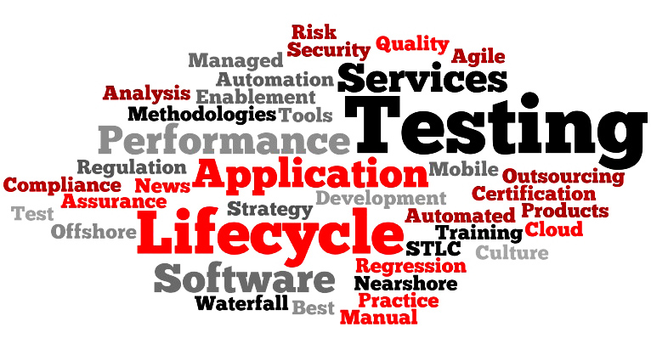
Learning 1 | My takeaways
We learnt about the various software testing types.
Like functional and non-functional testing, white black grey and green box testing.
Other types of testing included smoke, regression, performance and Ad-hoc testing.
We also learnt about the software testing hierarchy- acceptance, system, integration and unit testing.
We also learnt about STLC(System testing life cycle )model and bug life cycle model.
[Add a graphic that provides evidence of what you learned]

Slide 5
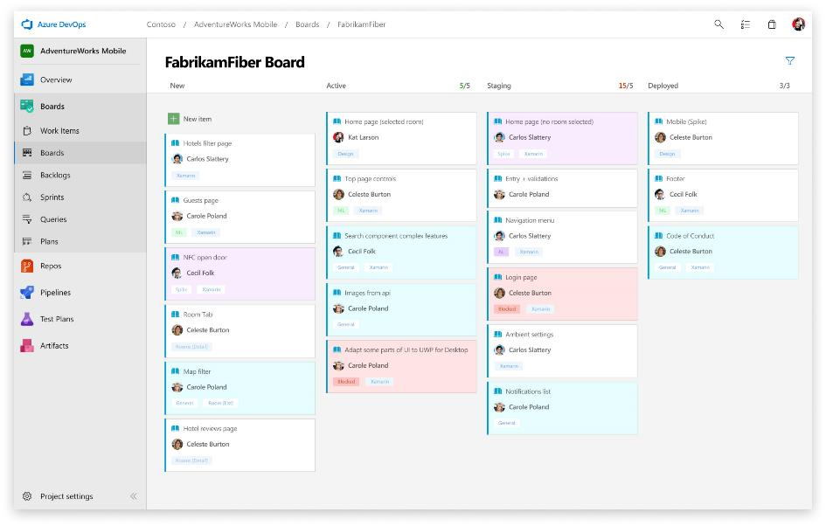
Learning 2 | My takeaways
We learnt how to write testcases. We also wrote user stories and acceptance criterias which can be used by testers to validate the working of the system.
We also learnt how to make bug reports. We also wrote test cases in gherkin language using the given when then and commands.
We learnt how to create vms using azure devops.
We also learnt about BDD (behaviour driven development ) and TDD (test driven development)
[Add a graphic that provides evidence of what you learned]

Slide 6
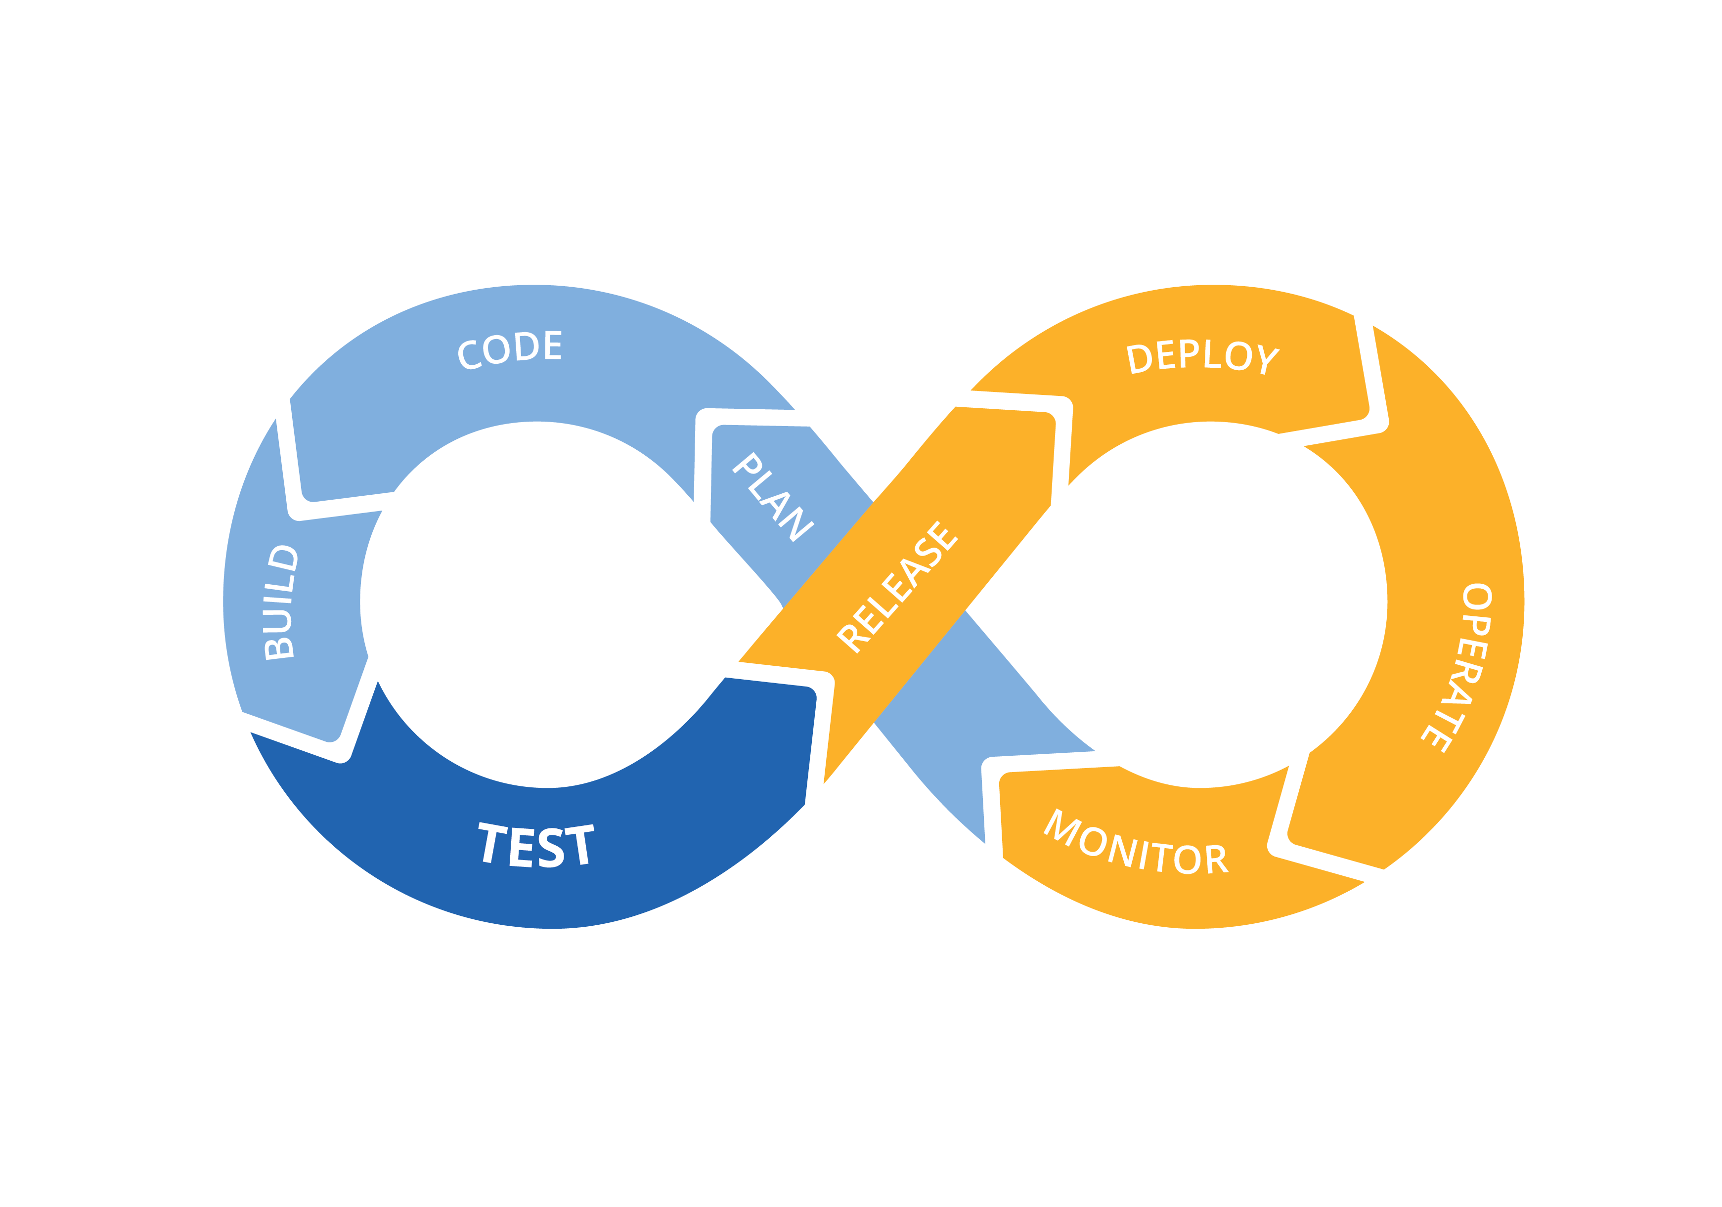
Learning 3 | My takeaways
We learnt the difference between severity and priority and how it is used to prioritize bugs.
We also learnt about the Devops tools, CI/CD pipeline and how to use Github actions to create a workflow.
We also learnt how to use the Fitnesse tool.
We also learnt DBMS – PostGreSQL commands and did hands on exercise on each of them.

Slide 7

Relevance of learnings for my organization

Slide 8

Learning 1 | Relevance for Shell
The knowledge about the various types of software testing models gives me more quality on how a software is tested and what are the criteria to keep in mind.
[Add a graphic that provides view of how Shell implements this learning]

Slide 9
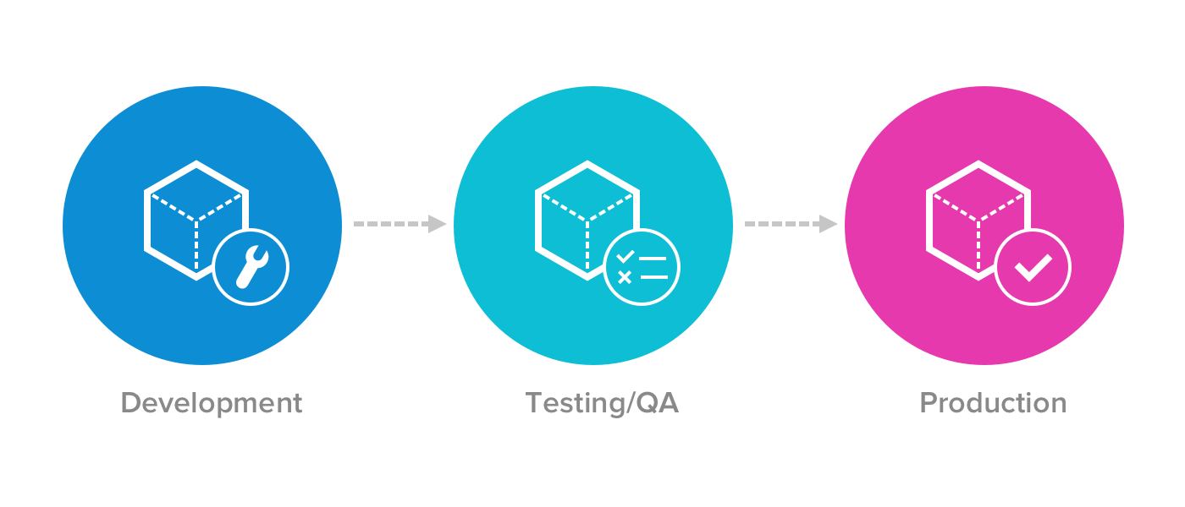
Learning 2 | Relevance for Shell
There are multiple development projects that keep going on in Shell. I think I can use these skills in the testing process for those to make sure no bug is there.
I can also write test cases, bug reports and user stories as required for the projects.

Slide 10

Learning 3 | Relevance for Shell
DBMS – Postgresql will help me handle data available in the backend. I learnt various sql commands that will help me with various operations required for data handling.
The CI/CD pipeline and Github Actions tools are very important for collaborative development of projects in an organization.
[Add a graphic that provides view of how Shell implements this learning]

Slide 11

Challenges in implementing learning

Slide 12

Challenge faced while implementing Learning 1
There was a lot of theory but once I understood the concepts thoroughly I was able to remember everything.

Slide 13
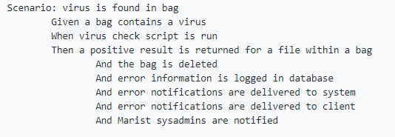
Challenge faced while implementing Learning 2
Initially I faced a little difficulty in writing the codes in gherkin but slowly understood it and wrote multiple testcases during the group activity.
[Add a graphic that provides evidence of what you did to overcome this challenge]

Slide 14
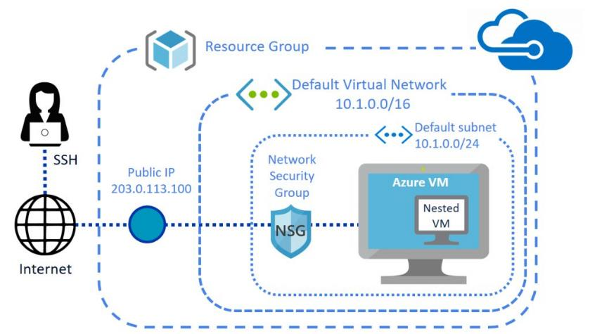
Challenge faced while implementing Learning 3
Creating the VM and using Github was a little confusing at first but the hands on exercises made it easier to understand.
[Add a graphic that provides evidence of what you did to overcome this challenge]

Slide 15

Action Plan

Slide 16
My Action Plan for this Week
Actions
Timeline
Status
More technical custom bootcamps are planned for the future days.
I will try to revise all my concepts before the new week starts.
On weekends revise the topics

Slide 17

Learning is also Fun!

Slide 18

Learning is also Fun!
We had multiple group activities were we were divided into groups of 6 people and we had to do tasks like making testcases, bug report and user stories on azure devops.

Slide 19

Summary
SOFTWARE TESTING LIFE CYCLE MODEL
BUG LIFE CYCLE
DEVOPS
CI/CD PIPELINE
DBMS – POSTGRESQL

Slide 20
Thank You

